Slide 1

Chapter 2
Software Testing Terminology and Methodology
Objectives
Difference between error, fault and failure.
Life Cycle of a bug.
How does a bug affect economics of software testing?
How does a bug classified?
Testing Principles
Software Testing Life Cycle (STLC) and its models.
Difference between verification and validation.
Development of software testing methodology
© Oxford University Press 2011. All rights reserved.

Slide 2
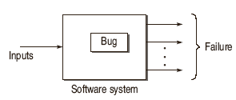
Software Testing Terminology
Failure
The inability of a system or component to perform a required function according to its specification.
Fault / Defect / Bug
Fault is a condition that in actual causes a system to produce failure.
© Oxford University Press 2011. All rights reserved.

Slide 3

Software Testing Terminology
Error
Whenever a member of development team makes any mistake in any phase of SDLC, errors are produced. It might be a typographical error, a misleading of a specification, a misunderstanding of what a subroutine does and so on. Thus, error is a very general term used for human mistakes.
© Oxford University Press 2011. All rights reserved.

Slide 4
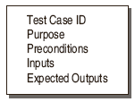
Software Testing Terminology
© Oxford University Press 2011. All rights reserved.

Slide 5
Software Testing Terminology
Testware
The documents created during the testing activities are known as Testware.
Incident
the symptom(s) associated with a failure that alerts the user to the occurrence of a failure.
Test Oracle
to judge the success or failure of a test,
© Oxford University Press 2011. All rights reserved.

Slide 6
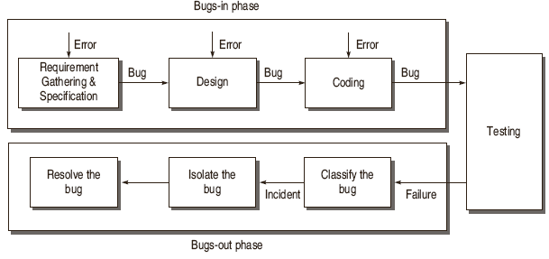
Life Cycle of a Bug
© Oxford University Press 2011. All rights reserved.

Slide 7
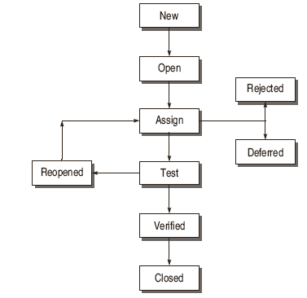
States of a Bug
© Oxford University Press 2011. All rights reserved.

Slide 8
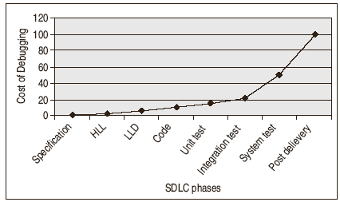
Software Testing Myths
Bug affects Economics of Software Testing
© Oxford University Press 2011. All rights reserved.

Slide 9
Bug Classification based on Criticality
Critical Bugs
the worst effect on the functioning of software such that it stops or hangs the normal functioning of the software.
Major Bug
This type of bug does not stop the functioning of the software but it causes a functionality to fail to meet its requirements as expected.
Medium Bugs
Medium bugs are less critical in nature as compared to critical and major bugs.
Minor Bugs
© Oxford University Press 2011. All rights reserved.

Slide 10
Bug Classification based on SDLC
Requirements and Specifications Bugs
Design Bugs
  Control Flow Bugs
  Logic Bugs
Processing Bugs
  Data Flow Bugs
  Error Handling Bugs
  Race Condition Bugs
  Boundary Related Bugs
  User Interface Bugs
Coding Bugs
Interface and Integration Bugs
System Bugs
Testing Bugs
© Oxford University Press 2011. All rights reserved.

Slide 11
Testing Principles
Effective Testing not Exhaustive Testing
Testing is not a single phase performed in SDLC
Destructive approach for constructive testing
Early Testing is the best policy.
The probability of the existence of an error in a section of a program is proportional to the number of errors already found in that section.
Testing strategy should start at the smallest module level and expand toward the whole program.
© Oxford University Press 2011. All rights reserved.

Slide 12
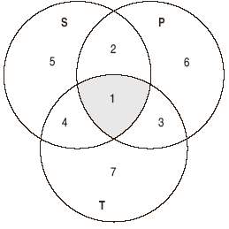
Testing Principles
Testing should also be performed by an independent team.
Everything must be recorded in software testing.
Invalid inputs and unexpected behavior have a high probability of finding an error.
Testers must participate in specification and design reviews.
© Oxford University Press 2011. All rights reserved.

Slide 13
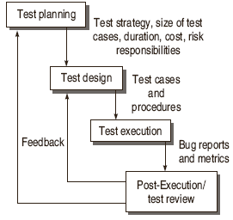
Software Testing Life Cycle (STLC)
© Oxford University Press 2011. All rights reserved.

Slide 14
Test Planning
Defining the Test Strategy
Estimate of the number of test cases, their duration and cost.
Plan the resources like the manpower to test, tools required, documents required.
Identifying areas of risks.
Defining the test completion criteria.
Identification of methodologies, techniques and tools for various test cases.
Identifying reporting procedures, bug classification, databases for testing, Bug Severity levels, project metrics
© Oxford University Press 2011. All rights reserved.

Slide 15
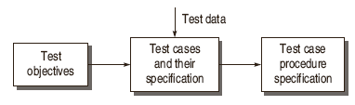
Test Design
Determining the test objectives and their Prioritization
Preparing List of Items to be Tested
Mapping items to test cases
Selection of Test case design techniques
Creating Test Cases and Test Data
Setting up the test environment and supporting tools
Creating Test Procedure Specification
© Oxford University Press 2011. All rights reserved.

Slide 16
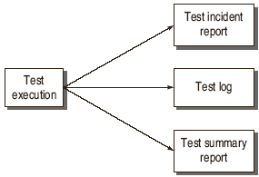
Test Execution
© Oxford University Press 2011. All rights reserved.

Slide 17
Post-Execution / Test Review
Understanding the Bug
Reproducing the bug
Analyzing the nature and cause of the bug
Reliability analysis
Coverage analysis
Overall defect analysis
© Oxford University Press 2011. All rights reserved.

Slide 18
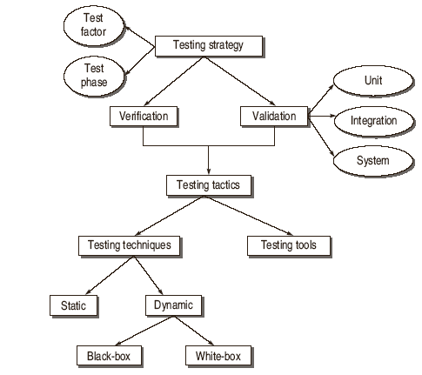
Software Testing Methodology
© Oxford University Press 2011. All rights reserved.

Slide 19
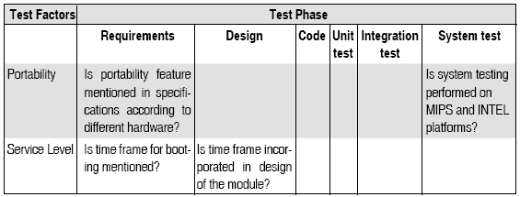
Test Strategy Matrix
Select and Rank Test Factors
Identify the System Development Phases
Identify the Risks associated with System under Development
© Oxford University Press 2011. All rights reserved.

Slide 20
Development of Test Strategy
Verification: “Are we building the product right?”
Validation: “Are we building the right product?”
© Oxford University Press 2011. All rights reserved.

Slide 21
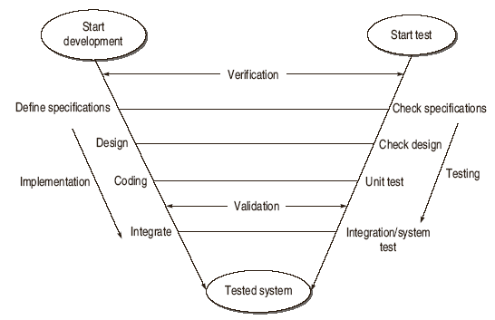
V Testing Life Cycle Model
© Oxford University Press 2011. All rights reserved.

Slide 22
Validation Activities
Unit Testing
Integration Testing
Function Testing
System Testing
Acceptance Testing
© Oxford University Press 2011. All rights reserved.

